Slide 1

E-COMMERCE WEBSITE
Mark.it
.

Slide 2

Group Member Details and Contributions
S. No. | Name | UID | Contribution
1. | Nishchita Jagadish | 20BCS5764 | Backend of the website
2. | Kamini Verma | 20BCS5839 | Frontend of the website
3. | Maulik Bhatnagar | 20BCS5814 | Frontend of the website
4. | Tanmay Srivastava | 20BCS5840 | Backend of the website

Slide 3

OBJECTIVE
Our aim is to design and develop an online shopping website using open source technologies (PHP, HTML5, CSS, JavaScript, MySQL and Apache Web Server) for products in India where customers will be able to buy products online.

Slide 4
INTRODUCTION
E-commerce (electronic commerce or EC) is the buying and selling of goods and services, over an electronic network, primarily the internet.
Technological advancement has made it possible for people to sit in the convenience of their homes and still shop online without going to a physical shop.
The website contains a main home page which is displaying the featured products and other services, a products page which displays the various products the website has to offer ranging from electronics, fashion movies and more. The about page containing the creators information, a contact us page which will allow users to get in touch with the creators with feedback, tips, etc. And finally an accounts page which contains a registration form which when filled stores the customer’s details into a database which can be viewed by the admin.

Slide 5

SOFTWARE AND HARWARE TOOLS REQUIRED
SOFTWARE:
HTML
CSS
JAVASCRIPT
PHP
MYSQL
HARDWARE
Processor (CPU) with 2 gigahertz (GHz) frequency or above
A minimum of 2 GB of RAM
Monitor Resolution 1024 X 768 or higher
A minimum of 20 GB of available space on the hard disk .Internet Connection Broadband (high-speed) Internet connection with a speed of 4 Mbps.
Keyboard and a Microsoft Mouse or some other compatible pointing device.

Slide 6
STEPS TO CREATE A WEBSITE
Creating a web site requires multiple steps which includes the following:
Creating a UI(User interface)
HTML
CSS
Scripting(Both at server end and client end)
Server side scripting: This scripting is done at the server end
Client side scripting: This scripting is done at the client end or the browser.
Creating a backend or the database
DBMS
MySQL
QUERIES

Slide 7
It includes the basic designing with good navigation skills.
The home page is designed in such a way that a person can have the complete synopsis of the site from the main page itself.
Views Website Logo, Banners or Slideshow which are integrated with Home Page
View list of Latest Products available with details like Product Title, Image, View links for Login and Sign Up. Clicking on any link, User will navigate that particular Page
HOME
PAGE

Slide 8
Users can browse products through category navigation or by performing a search. Search will be on keyword base and advance search option will be available on the website. Searching parameters for advance search would be:
PRODUCT
STRUCTURE
Price range
Brands
Categories

Slide 9


Clicking on main category will display the list of subcategories. Clicking upon the subcategory will display the list of products and services of subcategories corresponding to that category.

Slide 10
PRODUCTS DETAIL
PAGE:
Product name
Product Image
Option to view Videos
Price
Discounted Price (if any)
Buy Now Button
Quick View

Slide 11
Shop by color/size – This will display various color/sizes. Clicking upon the same will display the list of products in that color/size. And their price might be different as entered by admin.
In stock or Out of Stock

Slide 12
SHOPPING CART
Users add products of their interest to shopping cart before actually purchasing them. Once they are done, they can checkout to place their order. Shopping cart allows users to:
Add unlimited products
Manage quantity of individual product in the cart
Remove items from the cart
Empty cart
Confirm their order by checking out
Calculate discounted price by entering discount coupon code
Shopping cart is made easily accessible by placing them on all pages.

Slide 13
REGISTRATION FORM
Users can register themselves by filling up the below form:
First Name | Text field
Last Name | Text field
Gender | Drop down
Email | Text field
Password | Text field
Phone Number | Text field
ID(database) | Text field

Slide 14
ADD TO CART FORM
Users can add items to the cart themselves by filling up the below form:
First Name | Text field
Email | Text field
Fashion | Drop down
Electronics | Drop down
Entertainment | Drop down
Sports | Drop down
Address | Text field

Slide 15

RESULTS, SNAPSHOTS, CODING
RESULT
Therefore, after implementing all the mentioned libraries as well as software tools, we finally created our full-fledge website where users can make an account, log in, and browse the products of their choice, and give us their feedback.

Slide 16
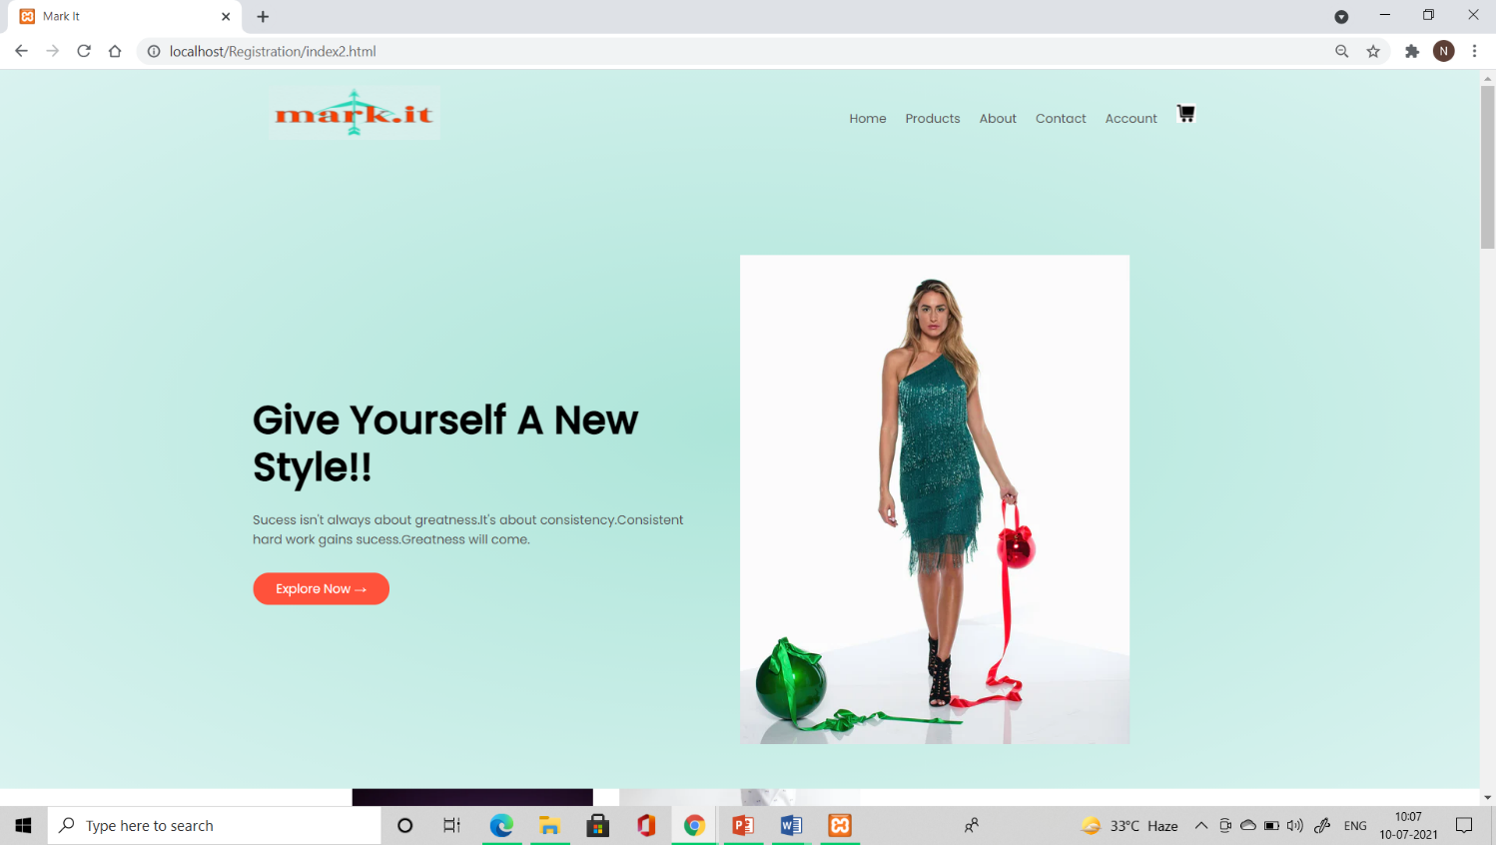

Slide 17
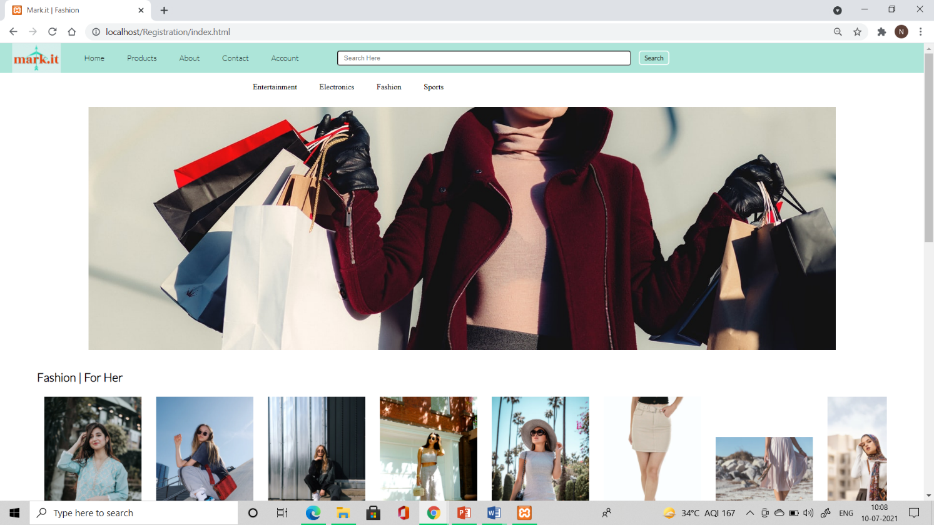

Slide 18
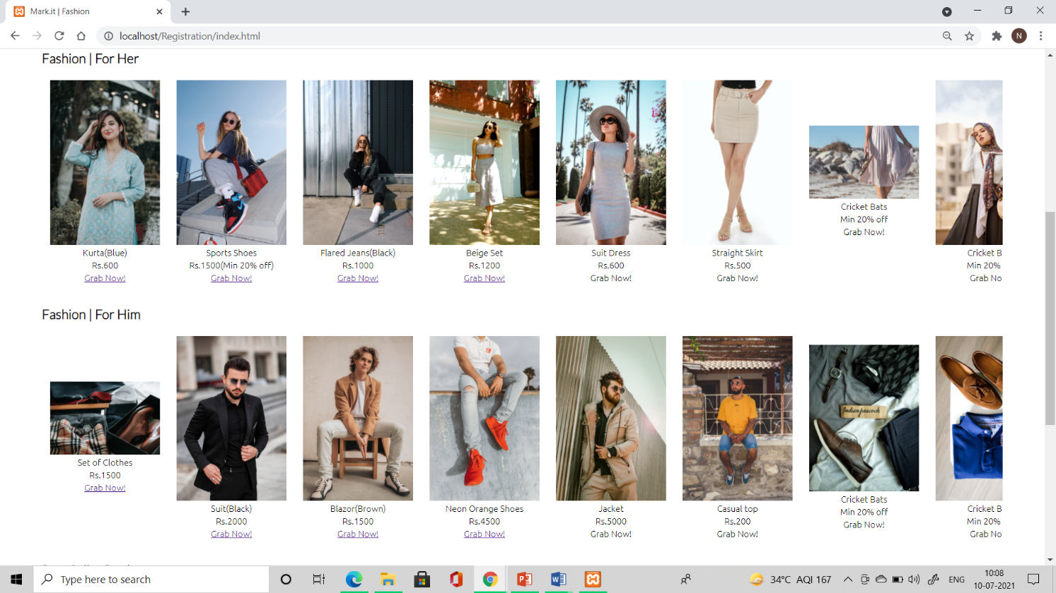

Slide 19
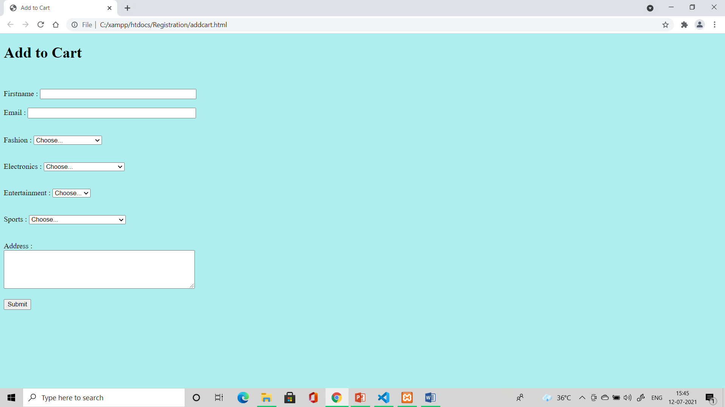

Slide 20
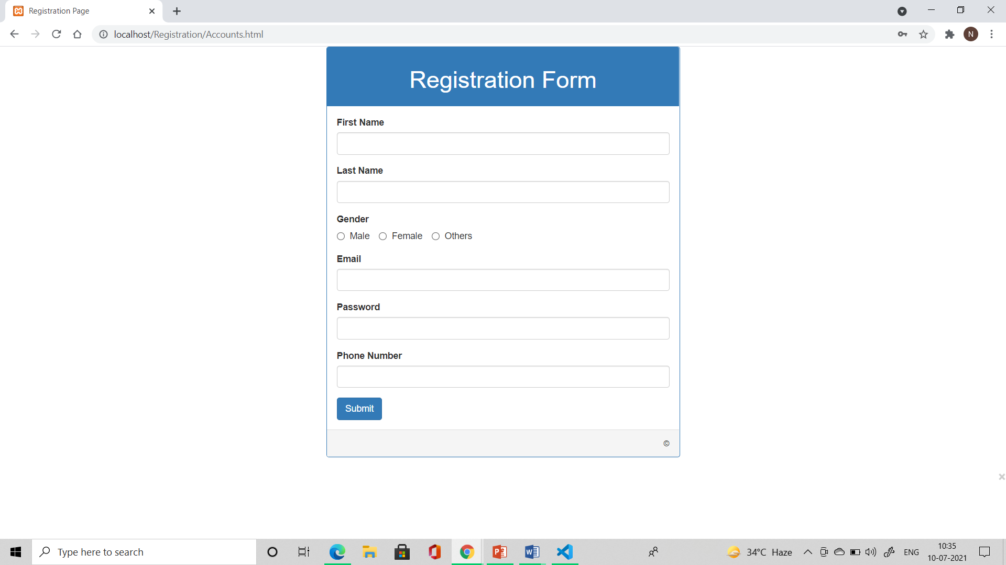

Slide 21
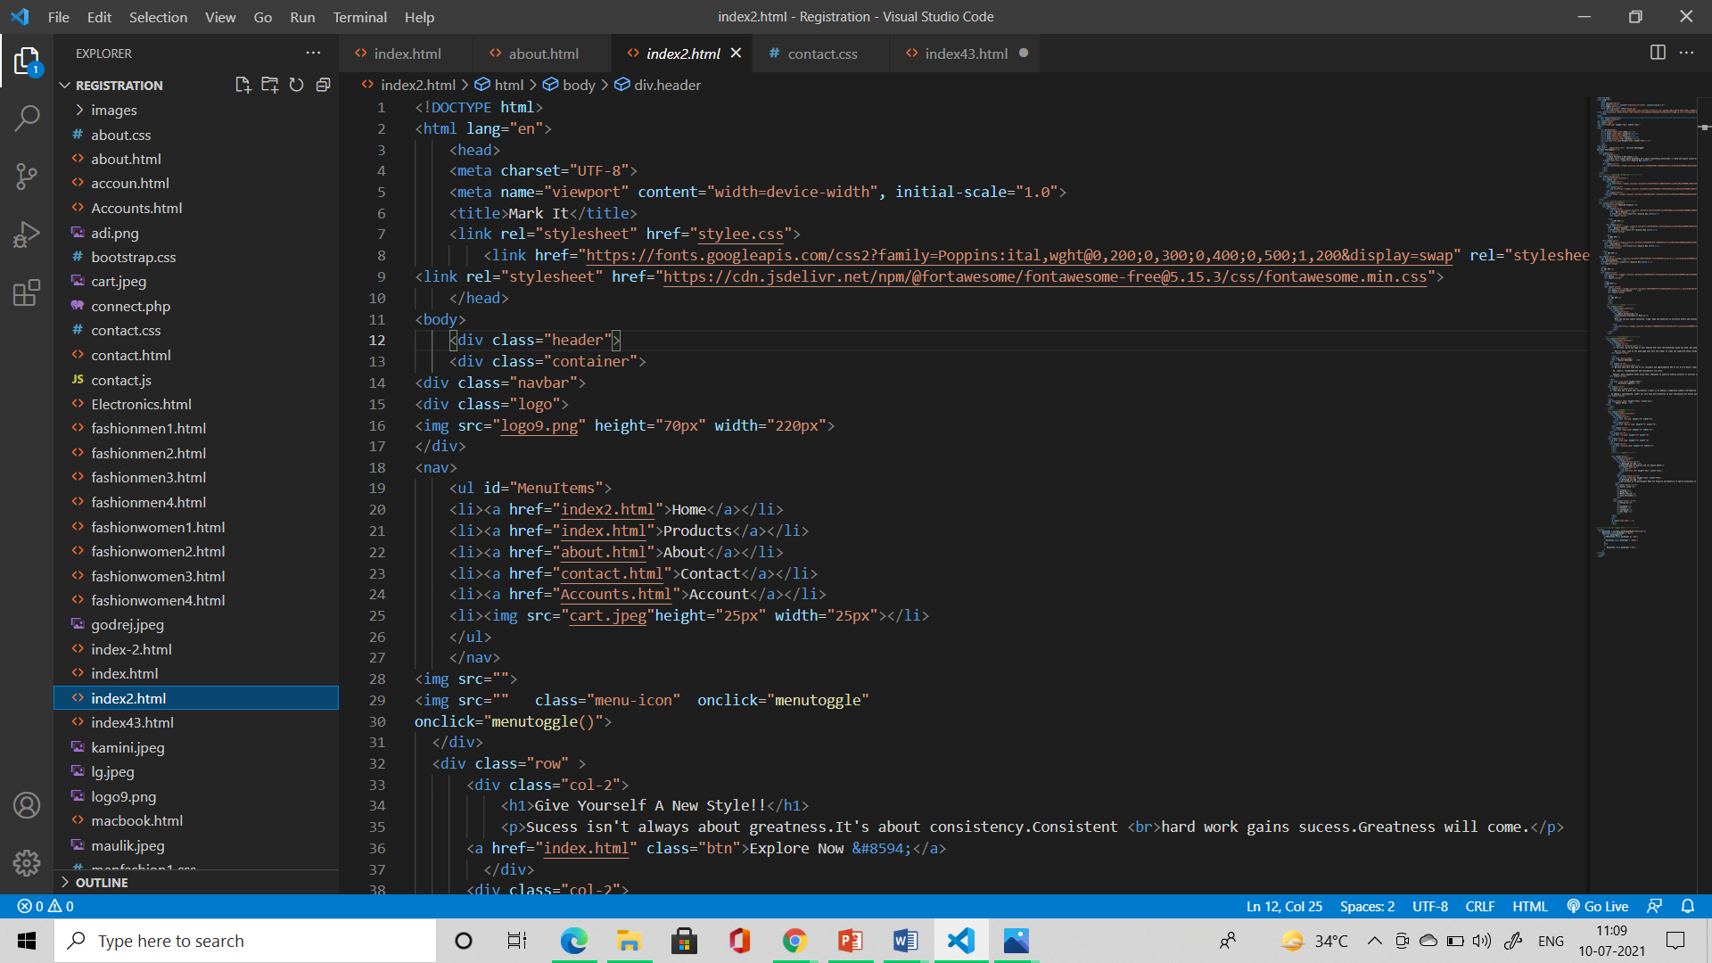

Slide 22
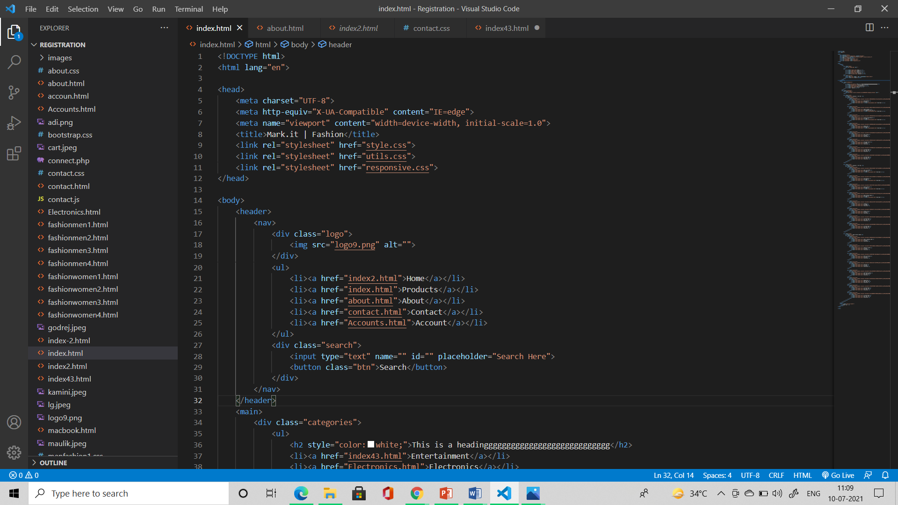

Slide 23
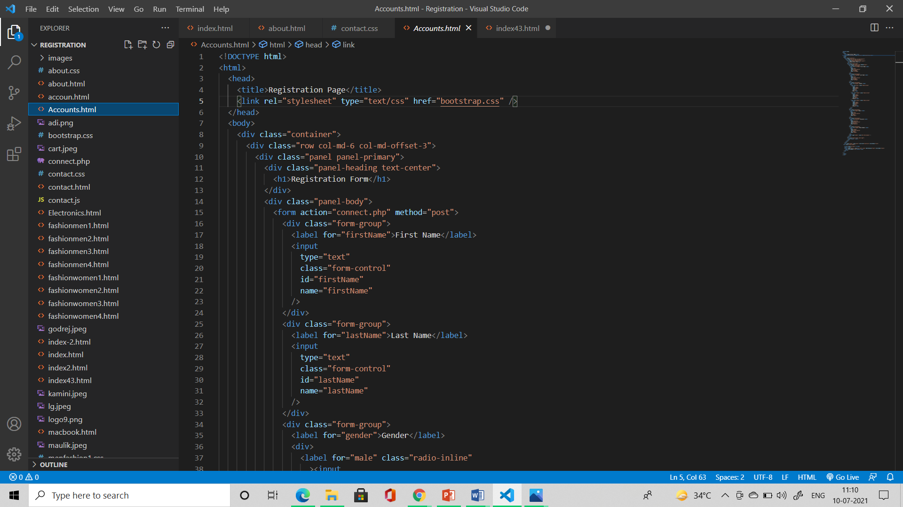

Slide 24
CONCLUSION AND FUTURE SCOPE
Our project is only a humble venture to satisfy the needs to manage their project work. Several user friendly coding has also been adopted. The objective of the software planning is to provide a framework with a limited project completion time frame at the beginning of the project and should be updated on a regular basis.

Slide 25
POSSIBLE FUTURE WORK
We can give more advance software for Ecommerce Website systems and add more facilities.
We can add ‘Quantities’ option in the future.
We can add the ‘favorites’ option and make it linked to database system in the future.
Create a backup mechanism for backing up data and information.
We will host the platform on online servers, to make it accessible worldwide.
Today, the market place is flooded with several Ecommerce website options for shoppers to choose from.
A variety of more innovative products can be added to the website.
Today, it is a reality in India, in the last couple of years, the growth of Ecommerce website industry in India has been phenomenal as more shoppers have started discovering the benefits of using this platform.
There is enough scope for online businesses in the future if they understand the Indian shoppers psyche and cater to their needs.

Slide 26
REFERENCES
[1] By Larry Ullman · 2010 Effortless E-Commerce with PHP and MySQL.
[2] By Max Bramer · 2015 Web Programming with PHP and MySQL A Practical Guide.
[3] By Anne Nelson, William H. M. Nelson · 2002 Building Electronic Commerce with Web Database Constructions.
[4] James McGaw · 2010 Beginning Django E-Commerce.
[5] By Janice Reynolds · 2004 The Complete E-Commerce Book Design, Build & Maintain a Successful Web-based Business.
[6] By Matthew MacDonald · 2015 Creating a Website: The Missing Manual.

Slide 27
Thank you!
Mark.it
.

